Slide 1



Air Quality Classification Using Machine Learning
NGDS Assignment 1
Notes:
1

Slide 2
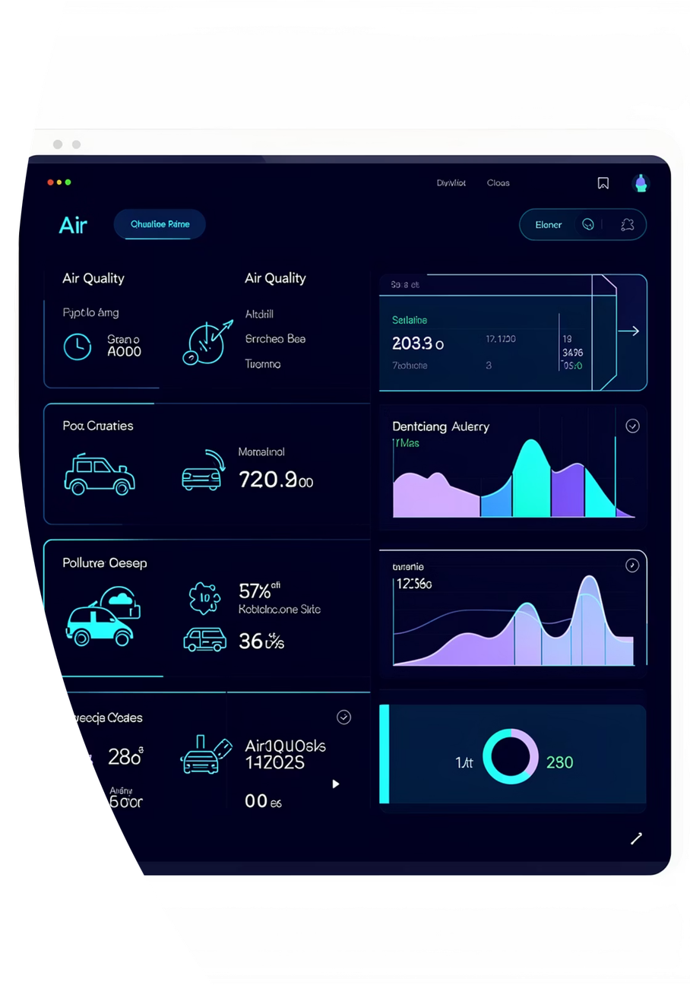
Project Objective
Urban air quality monitoring systems require early warning signals to protect public health. This project builds an end-to-end machine learning pipeline to classify pollution risk levels using multivariate sensor data from the UCI Air Quality dataset.
The target variable is engineered from a median threshold of NO₂ levels , creating a binary classifier that flags high-pollution conditions. We compare both manual ML pipeline development and automated machine learning approaches.
Notes:
2

Slide 3
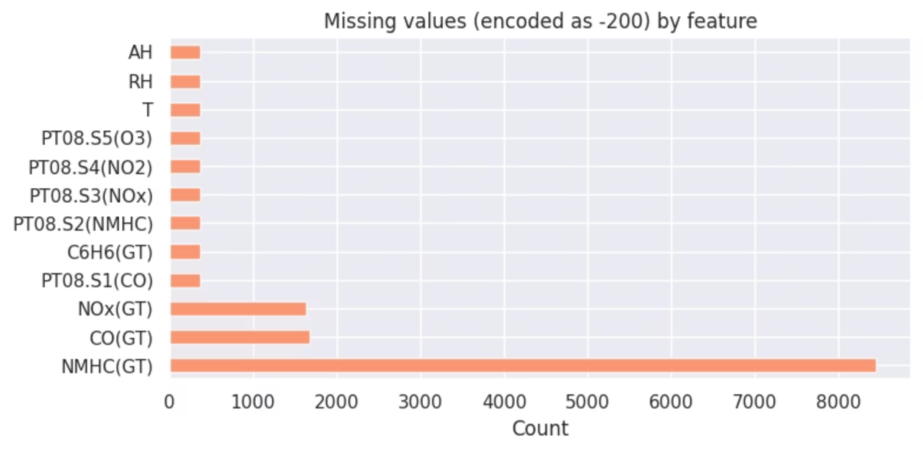
Dataset Overview
Source & Scale
UCI Air Quality dataset containing 9,358 hourly records with 15 sensor measurements across multiple gas species
Feature Types
Gaseous pollutants (NOx, CO, benzene)
Weather conditions (temperature, humidity)
Derived physical quantities
Missing Data
Sentinel value -200 indicates missing readings—a pattern requiring careful handling during preprocessing
Notes:
3

Slide 4
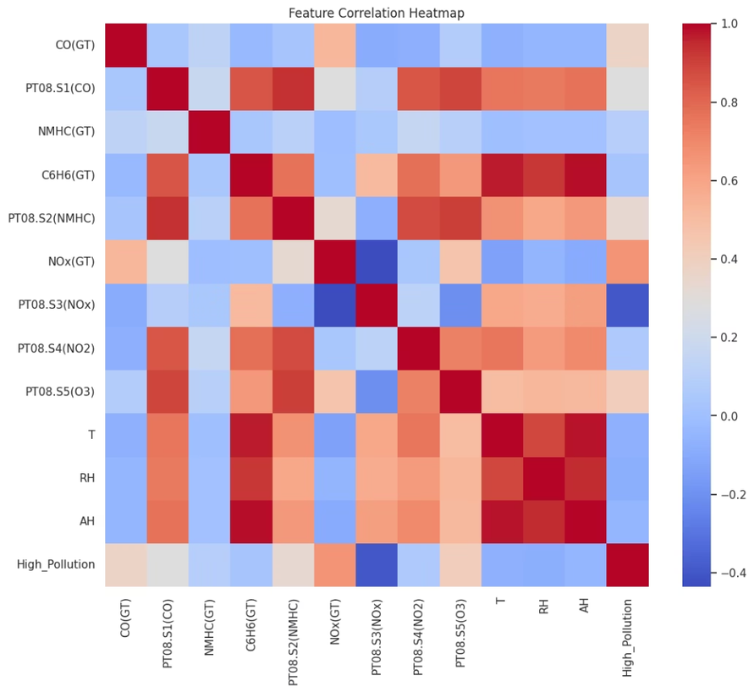
Exploratory Data Analysis
Descriptive statistics revealed wide variations in feature scales, prompting standardization. Distribution checks identified skewed variables that would benefit from transformation.
Missingness analysis confirmed consistent -200 sentinel pattern. Correlation matrices highlighted dependencies between pollutant sensors (e.g., NOx and NO₂ correlation > 0.7).
Feature-class boxplots demonstrated clear signal differences between below-threshold and above-threshold NO₂ conditions, validating class separability.
Notes:
4

Slide 5
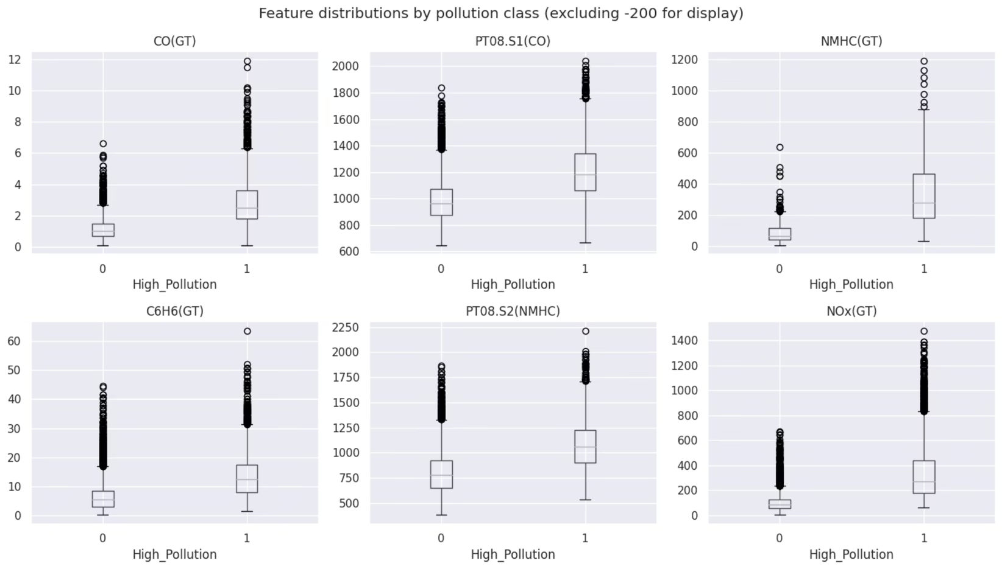
Feature Distributions by Pollution Class
Notes:
4

Slide 6





Feature Engineering & Preprocessing
Clean Missing Values
Replace sentinel -200 with NaN for robust missing data handling
Impute Strategically
Median imputation provides outlier resistance
Engineer Features
Create target variable to be pollution level derived from NO₂ column.
Standardize & Reduce
Feature standardization and PCA retaining 95% variance
Notes:
5

Slide 7
ML Pipeline Architecture
Train/Test Split
Preprocessing Pipeline
X_train, X_test, y_train, y_test = train_test_split(
X, y, test_size=0.2, random_state=42, stratify=y
)
numeric_pipeline = Pipeline(steps=[
("imputer", SimpleImputer(
strategy="median")),
("scaler", StandardScaler()),
("pca", PCA(n_components=0.95)),
])
The data is split into 80% training and 20% test sets using stratified sampling to maintain class distribution. The random_state=42 ensures reproducibility, while stratify=y preserves the proportion of high-pollution vs normal conditions in both sets.
This pipeline handles all numeric features through three sequential steps: median imputation for missing values, standardization to normalize feature scales, and PCA to reduce dimensionality while retaining 95% of variance.
ColumnTransformer
Unbiased Evaluation
preprocessor = ColumnTransformer([
("num", numeric_pipeline,
num_features),
])
Train/test split ensures models are evaluated on truly unseen data.
Fair Comparison
The ColumnTransformer applies the numeric_pipeline consistently to all numeric features, ensuring identical preprocessing across the dataset and preventing data leakage.
Identical preprocessing applied to all models enables fair performance benchmarking.
Notes:
6

Slide 8
Models Trained
Logistic Regression Pipeline
Random Forest Pipeline
log_model = Pipeline(steps=[
("preprocessor", preprocessor),
("classifier", LogisticRegression(
max_iter=1000))
])
log_model.fit(X_train, y_train)
from sklearn.ensemble import (
RandomForestClassifier)
rf_model = Pipeline(steps=[
("preprocessor", preprocessor),
("classifier", RandomForestClassifier(
random_state=42))
])
rf_model.fit(X_train, y_train)
The Logistic Regression model is wrapped in a Pipeline with the preprocessor. The max_iter=1000 ensures convergence on this dataset. This interpretable baseline provides coefficients for feature importance analysis and uses linear decision boundaries.
The Random Forest model is similarly wrapped in a Pipeline with the preprocessor. The random_state=42 ensures reproducibility. This ensemble approach captures non-linear relationships and complex pollutant interactions through multiple decision trees.
Notes:
7

Slide 9
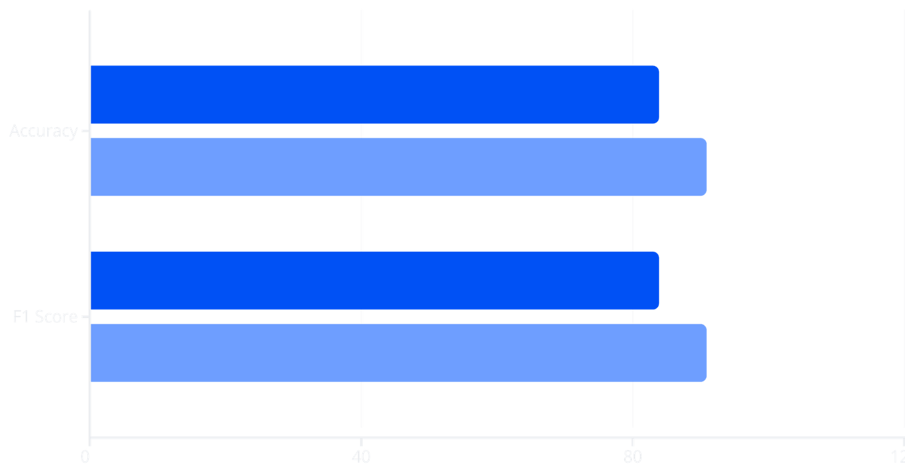
Performance Evaluation
Logistic Regression
Random Forest
Test Accuracy: 0.84
Test Accuracy: 0.91
Macro F1: 0.84 | Weighted F1: 0.84
Macro F1: 0.91 | Weighted F1: 0.91
LR
RF
Notes:
8

Slide 10
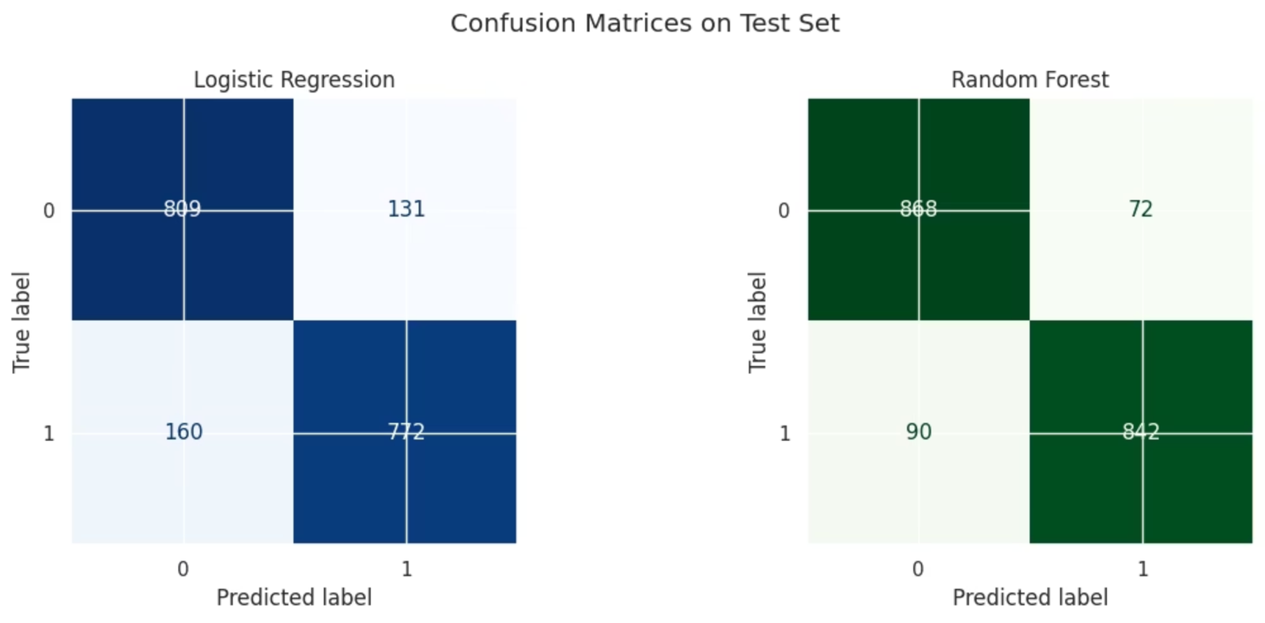
Notes:
8

Slide 11
Hyperparameter Tuning
Manual Random Forest Tuning
GridSearchCV with 3-fold cross-validation optimized for macro F1 score
Parameter grid explored: n_estimators [100, 200], max_depth [None, 10, 20]
Best configuration achieved 0.91 cross-validation F1, consistent with test performance
GridSearchCV Implementation
# Define parameter grid
param_grid = {
'classifier__n_estimators': [100, 200],
'classifier__max_depth': [None, 10, 20]
}
# Setup GridSearchCV
grid_search = GridSearchCV(
rf_model,
param_grid,
cv=3,
scoring="f1_macro",
n_jobs=-1
)
grid_search.fit(X_train, y_train)
Best Parameters Found
Best Parameters:
classifier__max_depth = 20
classifier__n_estimators = 100
Best CV F1 Score: 0.91
Best Estimator Pipeline
Pipeline(steps=[
('preprocessor', ColumnTransformer(transformers=[
('num', Pipeline(steps=[
('imputer', SimpleImputer(strategy='median')),
('scaler', StandardScaler()),
('pca', PCA(n_components=0.95))
]), numeric_features)
])),
('classifier', RandomForestClassifier(
max_depth=20,
n_estimators=100,
random_state=42
))
])
Notes:
9

Slide 12
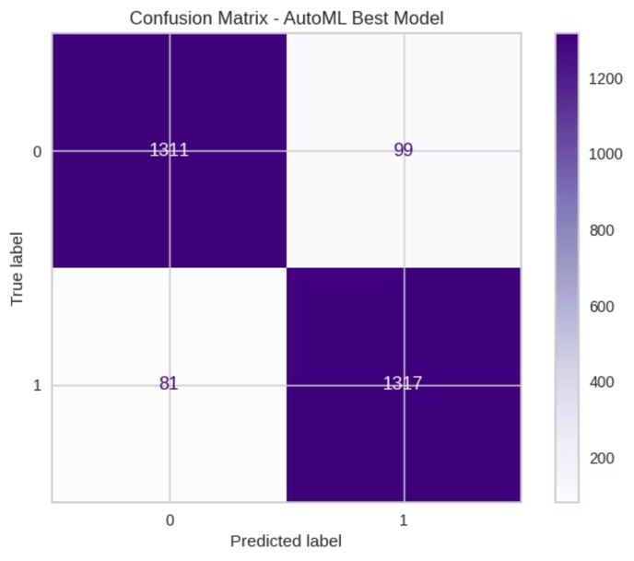
AutoML
PyCaret AutoML
Compared additional classifiers: Gradient Boosting, XGBoost, LightGBM, SVM
Manual modeling provides control and transparency; AutoML offers broad model exploration
Combined approach balances efficiency with understanding
AutoML Best Model Confusion Matrix
Notes:
10

Slide 13
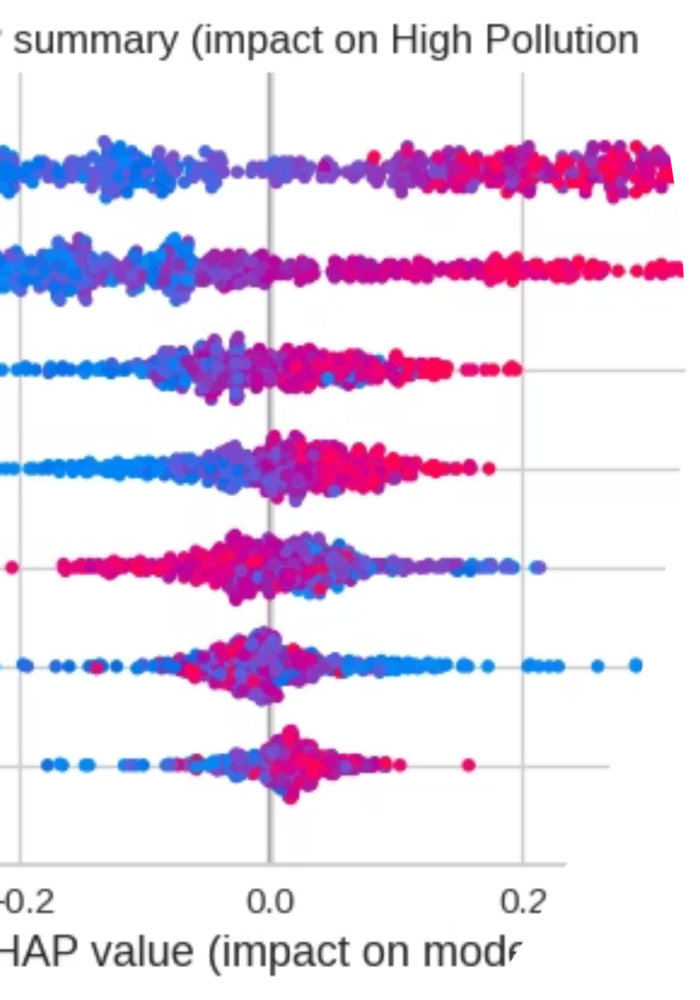
Explainable AI
SHAP Framework
Feature Importance
SHAPley Additive exPlanations provides both local and global interpretability through cooperative game theory
Top contributors: PC1 and PC2
Notes:
11

Slide 14
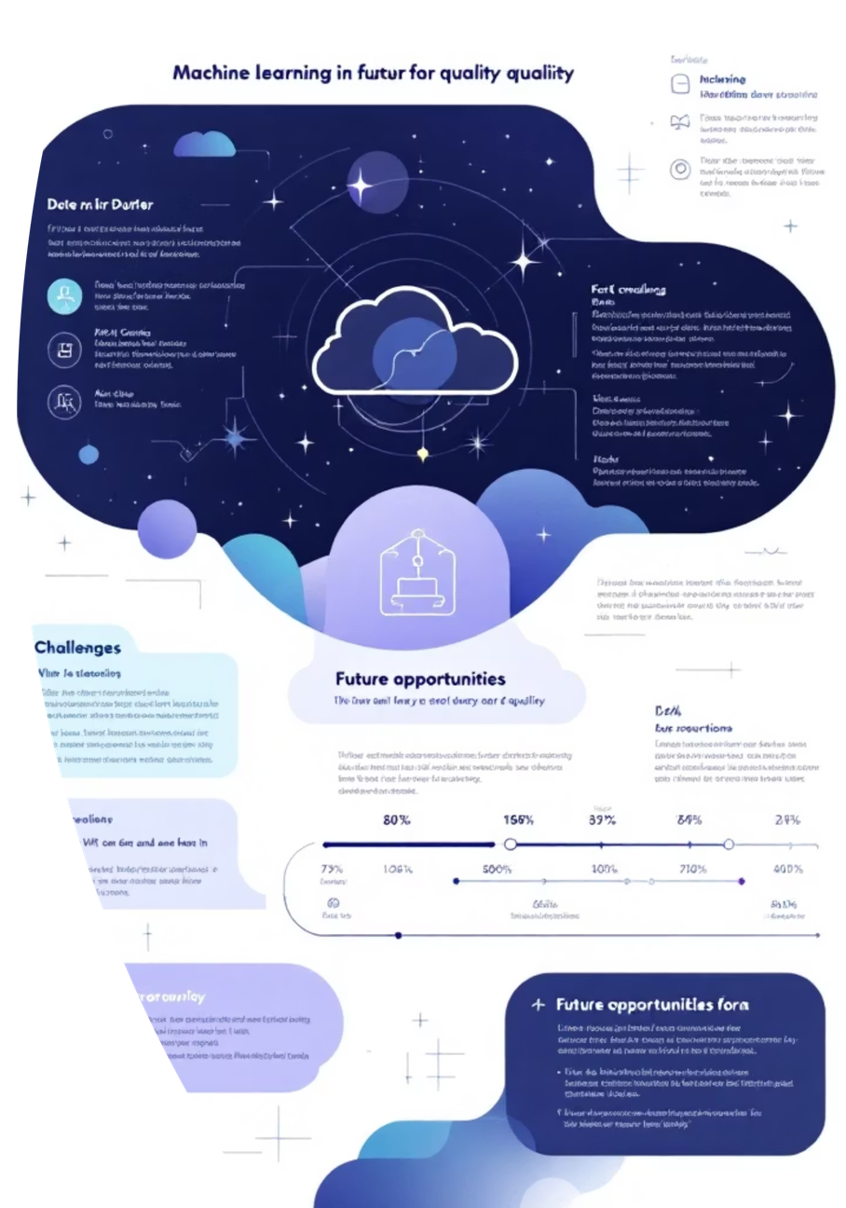
Limitations & Future Work
Current Limitations
Future Work
Binary classification based on a static median NO₂ threshold, which might oversimplify complex pollution dynamics.
This project may be limited by the dataset size and quality, so the model might not work as well on new real-world data.
Implement advanced time-series models (e.g., LSTMs, Prophet) to capture temporal patterns.
Expand to multi-class air quality categories, aligning with regulatory standards (e.g., EPA's AQI).
Develop a framework for real-time deployment, including automated data ingestion and periodic model retraining.
Notes:
12

Slide 15
Conclusion & Q&A
End-to-End Pipeline
Model Performance
Successfully developed and implemented, covering preprocessing to evaluation.
Random Forest significantly outperformed the Logistic Regression baseline.
Explainable AI
SHAP framework provided transparent and actionable insights into model predictions.
This project demonstrates a practical and reproducible path from raw sensor data to explainable air-quality risk classification.
Notes:
13

